Slide 1
+
Introduction to Computer Ethics
Software Engineering Professional Ethics Fatama Binta Rafiq

Slide 2

Background Of Ethics
Ethics: a set of beliefs about right and wrong behavior.
According to Socrates (Greek philosopher, 477 - 399 BC):People will naturally do what is good, if they know what is right
Evil or bad actions (Hacking Cyber Crimes)are the result of unawareness about right and wrong
so, if a criminal were truly aware of the mental and spiritual consequences of his actions, he would neither
commit nor even consider committing them
therefore, any person who knows what is truly right will automatically do it

Slide 3

Definition
Ethics: “The science of morals; the department of study concerned with the principles of human duty. The moral principles by which a person is guided.” – Oxford English Dictionary
Moral: “Of or pertaining to character or
disposition, considered as good or bad, virtuous or vicious; of or pertaining to the distinction between right and wrong, or good and evil, in relation to the
actions, volitions, or character of responsible beings; ethical.” – Oxford English Dictionary
Terms will be used interchangeably – basically, knowing the difference between right and wrong.

Slide 4

Introduction
In the industrialized world computers are changing everything: from education to health, from voting to making friends or making war.
Developing countries can also fully participate in cyberspace and make use of opportunities offered by global networks.
We are living a technological and informational revolution.
It is therefore important for policy
makers, leaders, teachers, computer professionals and all social thinkers to get involved in the social and ethical impacts of this communication technology.

Slide 5

Computer Ethics
The components of an ethical computer system are responsibility, ownership, access and personal privacy.
Responsibility concerns the accuracy and accountability of the
information (using information properly)
Ownership deals with who has the right to use the information (information belongs to)
Access deals with who is allowed to use, view, store and process
the information. (eligible to use information)
Personal privacy addresses the question of who the information belongs to (respect of personal information)

Slide 6





Impact of Cyber-Crime
1. Fraud and Embezzlement
The most significant losses to businesses from computer crime come from employees.
Losses from credit card fraud are estimated to be between $1and $4 billion per year.
ATM fraud accounts for losses of about $60 million a year
Telecommunications fraud estimated around $1 to
$9 billion each year.
Why? Tradeoff between convenience and security

Slide 7
2. Sabotage and Information Theft
Direct destruction of hardware, software or information
Use of “logic bombs”
An employee fired from an insurance company was convicted for destroying more than 160,000 records.
British Airways paid a competitor $4 million after hacking into their computers and stealing passenger lists.
Identity Theft (Information Collection, Privacy

Slide 8

3. Hacking and Cracking
Kevin Mitnick, a notorious hacker, was arrested in 1995.
He allegedly stole thousands of files from a computer security expert, credit card numbers, and unreleased software. (Book: Takedown by T. Shimomura)
High-Tech Low-Tech tricks:
Social Engineering, Shoulder Surfing
Clifford Stoll’s The Cuckoo’s Egg written about tracking a German hacker.
In the 1970’s John Draper discovered that the whistle in a cereal box could be used to fool the telephone system into giving free long-distance calls.

Slide 9



Cyberethics and cybertechnology
Cyber-technology refers to a broad range of technologies from stand-alone computers to the cluster of networked computing, information and communication technologies.
Cyber-ethics is the field of applied ethics that examines moral, legal, and social issues in the development and use of Cyber-technology.
Internet ethics and information ethics.

Slide 10

Computer ethics: definition
Same as cyber-ethics, or
The study of ethical issues that are associated primarily with computing machines and the computing profession.
The field of applied professional ethics dealing with ethical problems transformed, or created by computer technology

Slide 11


Computer Ethics:
Some historical milestones
1940-1950: Founded by MIT prof Norbert Wiener: cybernetics-science of information feedback systems.
1960s: Donn Parker from California examined unethical and illegal uses of computers by professionals. 1st code of professional conduct for the ACM.
1970: Joseph Weizenbaum, prof at MIT, created Eliza.
Mid 1970: Walter Maner taught 1st course and starter kit in computer ethics.

Slide 12

Computer ethics history (cont.)
1980: Issues like computer-enabled crime, disasters, invasion of privacy via
databases, law suits about software ownership became public.
Mid 80s: James Moore of Darmouth, Deborah Johnson of Rensselaer, Sherry Turkle of MIT, and Judith Perrole published article and books.

Slide 13
Computer ethics history (cont.)
1990: Interest in computer ethics as a field of research had spread to Europe and Australia.
Simon Rogerson of De Montfort University (UK)
Terrell Bynum, editor of Metaphilosophy (USA), initiated international conferences.
Mid 90s: Beginning of a 2nd generation of computer ethics with more practical action.
2004: Interest spreads to Cotonou, Benin

Slide 14



Any unique moral issues? Deborah Johnson: Ethics on-line
The scope of the Internet is global and interactive.
The Internet enables users to interact with privacy.
Internet technology makes the reproducibility of information possible in ways not possible before.
The above features make behavior on-line morally different than off-line.

Slide 15

The debate continues:
James Moore: Computer technology is “logically malleable” unlike previous technologies. It can create “new possibilities for human action”.
Brey: disclosing non-obvious features embedded in computer systems that can have moral implications.
Alison Adams: Take into account gender-related biases. Combine feminist ethics with empirical studies.

Slide 16

Sample topics in computer ethics
Computers in the workplace: a threat to jobs? De- skilling? Health and safety?
Computer security: Viruses. Spying by hackers.
Logical security:
Privacy, integrity, consistency, controlling access to resources.
Software ownership: Intellectual property vs. open source.
Software development: quality, safety

Slide 17

Computers in the workplace
Monitoring of employees: employer vs. employee point of view.
Loyalty
Health issues.
Use of contingent workers.
A threat to jobs.
De-skilling.

Slide 18

Computer security
Viruses: programming code disguised
Worms: propagate w/o human intervention(involvement)
Trojan horses: gets secretly installed.
Logic bombs: execute conditionally.
Bacteria or rabbits: multiply rapidly.
Computer crimes: embezzlement(theft, misuse, stealing).
Hackers: vandalism or exploration.

Slide 19

Logical security
Privacy invasion of email, files, and own computer (cookies).
Shared databases.
Identity theft.
Combating terrorism: USA Patriot act.

Slide 20

Software ownership
Knowledge: private greed, public good.
Profit vs. affordability
Freedom of expression and access to information
Right to communicate: share and learn in a globalized world.
Digital divide is immoral.
Open source software: Linux. Open access.
North-South information flow. Indigenous knowledge.

Slide 21

Codes of ethics
Avoid harm to others
Be honest and trustworthy
Acquire and maintain professional competence
Know and respect existing laws pertaining to professional work
No personal interest
Be honest and realistic in stating claims or estimates based on available data

Slide 22

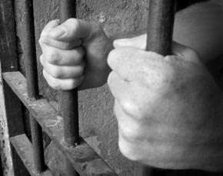
Cases in 2012
Cyber criminals target
Skype, Facebook and Windows users
Cyber criminals targeted users of Skype, Facebook and Windows using multiple Blackhole exploits in October, according to the latest threat
report from security firm GFI Software.
Researchers uncovered a large number of Blackhole exploits disguised as Windows licences, Facebook accountverification emails, Skype

Slide 23

Cases Continues
Cyber attackers increasingly targeting applications, research shows
Web and mobile applications are the new frontiers in the war against cyber attack, according to a top cyber security risks report from Hewlett Packard (HP) published in May.
The report reveals that SQL injection (SQLi) attacks on web applications increased sharply from around 15 million in 2010 to more than 50 million in 2011.

Slide 24


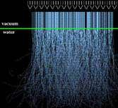
Case Continues
Therac-25
Therac-25 was a medical linear accelerator, a device used to treat cancer. What made Therac-25 unique at the time of its use was the software. Not only did the software ease the laborious set-up process, but it also monitored the safety of the machine. In this case on safety critical software, you will find that some patients received much more radiation than prescribed despite the software

Slide 25
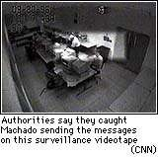
Case Continues
Machado
At age19, Richard Machado was the first individual to be convicted of a federal electronic mail (e-mail) hate crime. The Machado case is one example of a handful of similar incidents that have occurred since the advent of the Internet.

Slide 26



Case Continues
Hughes Aircraft
Between 1985 and 1987, the Microelectronic Circuits Division of Hughes Aircraft shipped hybrid microelectronics to every branch of the U.S. military without completing various environmental chip testing processes required by contract. This is a whistle-blower case where the allegations against Hughes Aircraft resulted in a criminal case and a civil case.

Slide 27



Cyber-Crime Cases
For more Cyber cases follow the link below
http://www.computerweekly.com/news/2240174301/ Top-10-cyber-crime-stories-of-2012
http://abcnews.go.com/US/harvard-ethics-student- charged-hacking-mit-computer/story?id=14110364

Slide 28
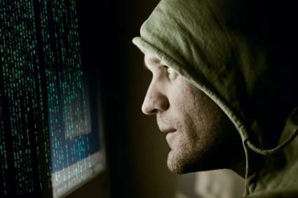
Ten Commandments
 1. Not use a computer to harm other people. This is the foundation for computer ethics.

Slide 29

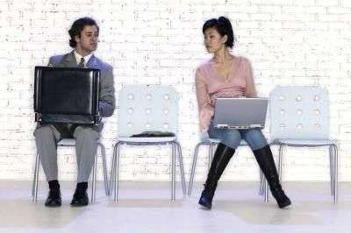
Ten Commandments
 2. Not interfere with other people’s computer work. Such as sending numerous thoughtless e-mails to larger issues like purposely sending computer viruses.

Slide 30
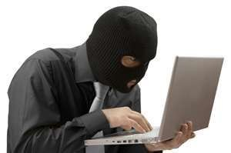
Ten Commandments
 3. Not snoop around in other people’s computer files. Don’t go looking through other people’s computer files unless given permission.

Slide 31
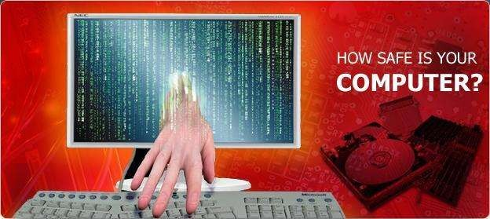
Ten Commandments
 4. Not use a computer to steal.

Slide 32
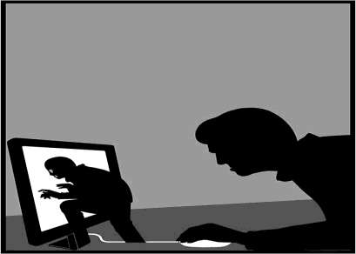
Ten Commandments
 5. Not use a computer to bear false witness. Don’t spread rumors or change your email address so that the receiver of an email believes that it came from someone other than yourself.

Slide 33
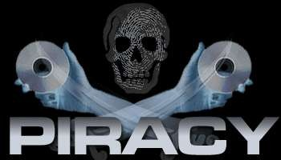
Ten Commandments
 6. Not copy or use proprietary software for which you have not paid. Once you buy a software system, music CD or DVD you should not make copies of that information and distribute it to your friends.

Slide 34
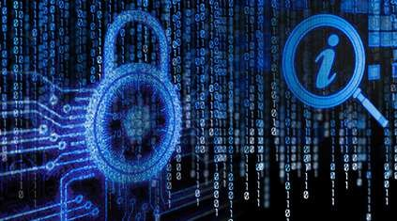
Ten Commandments
 7. Not use other people’s computer resources without authorization or proper compensation. This means do not surf the internet or print off large amounts of paper for personal use during work hours.

Slide 35
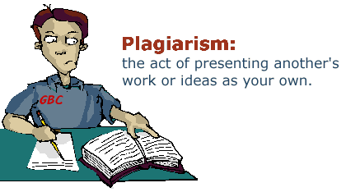
Ten Commandments
 8. Not appropriate other people’s intellectual output.
Don’t upload information and take credit for it such as music, images and text.

Slide 36
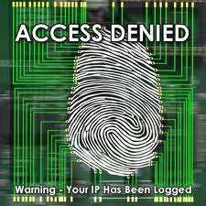
Ten Commandments
 9. Think about the social consequences of the program you are writing or the system you are designing.

Slide 37
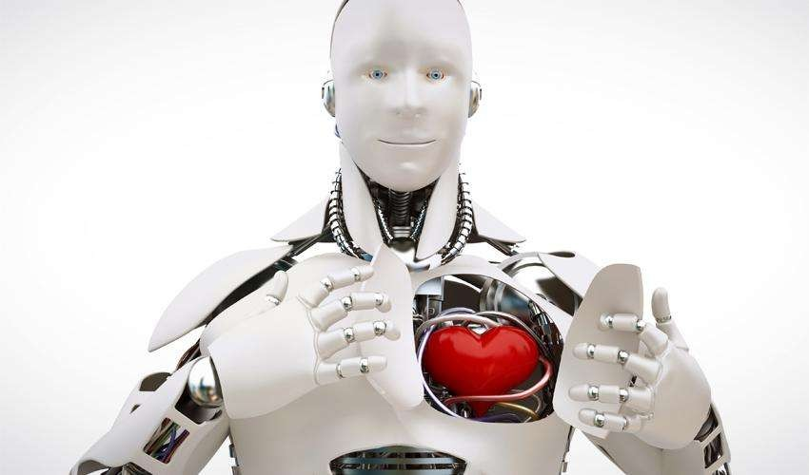
Ten Commandments
 10. Use a computer in ways that ensure consideration and respect for your fellow humans. Just because you can’t always see someone face to face doesn’t give you the right to offer any less respect then you would offer in a personal encounter.

Slide 38

CASE STUDY
http://www.mit.edu/activities/safe/safe/cases/umich- baker-story/Baker/timeline.html
http://www.mit.edu/activities/safe/safe/cases/umich- baker-story/throwout.1

Slide 39

International Papers Links
http://www.ijie.org, International Journal of Information Ethics.
www.sans.org/topten.htm Top ten Internet security flaws that system administrators must eliminate to avoid becoming an easy target.
http://ethics.csc.ncsu.edu/ Computer ethics as a map.
http://www.neiu.edu/~ncaftori/ethics-course.htm
The ethics course I borrowed these overheads from.

